Slide 1
Econometrics of Firm Data
Exercise Class 3 – Problem Sets 5 + 6
Mette Suder Franck, msf.eco@cbs.dk
DVIP, Department of Economics

Slide 2
Problem Set 5 - Panel Data Models
Exercise 5.1
Marketing firms are interested in knowing how potential customers respond to the design of logos. In neuromarketing, the effect of a stimulus is measured in various ways, including facial coding to categorize the physical expression of emotion. This exercise uses facial expression data on browfurrow, joy and facial asymmetry that was recorded in an experimental setting. 27 individuals have been presented a sequence of four new draft logos of a business association and various distractors. We have data for each so called stimulus for the first 10 seconds they are shown to participants. While the distractors are not supposed to result in a physical expression, the goal of the exercise is to test whether the draft logos lead to any response. The responses for each individual are plotted for the 4 logos in Figures browfurrow logoX.pdf, joy logoX.pdf and frontalasymmetry logoX.pdf.
Responses:
Brow Furrow and Joy are facial expression measures and represent the % probability that the respondents face was expressing that emotion at that time sample. 100 for Joy means there is a 100% probability that the respondent was expressing Joy at that time sample.
Frontal Asymmetry ranges from -1 to 1 and is a measure of "lean in vs lean back behavior". +1 is the highest rate of "leaning in" or engagement/interest and -1 is the lowest rate of "leaning in" or avoidance behavior.
Let’s have a closer look at the data!
Note: Use motion.dta for this exercise. The data (motion.dta) is kindly being provided by Imotions A/S.

Slide 3
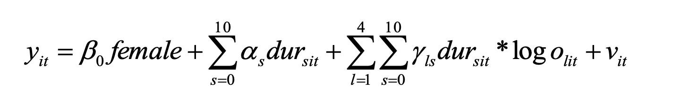
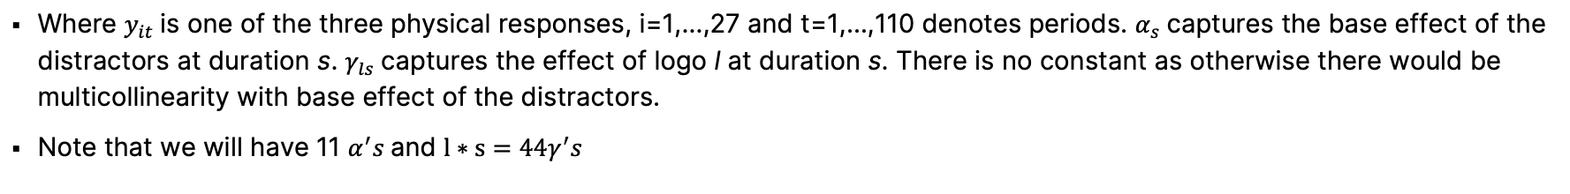
Problem Set 5 - Panel Data Models
Exercise 5.1
(a) On the grounds of the data available, how would you estimate the base effect of showing any distractor and the effect of showing the 4 logos? Write down the panel data model.
Where $y_{it}$is one of the three physical responses, i=1,…,27 and t=1,…,110 denotes periods. $α_{s}$captures the base effect of the distractors at duration s. $γ_{ls}$captures the effect of logo l at duration s. There is no constant as otherwise there would be multicollinearity with base effect of the distractors.
Note that we will have 11 $α^{′}s$and $l∗s=44γ^{′}s$
Note: Use motion.dta for this exercise.

Slide 4
Problem Set 5 - Panel Data Models
Exercise 5.1
(b) Estimate the model by POLS.
The POLS results for the model in a) suggest that most of the alphas and gammas are insignificant. The alphas are small and there is no indication that the distractors cause some sort of physical expression. For the logos, some of the cofficients are partly economically sizable but in most cases there is a lack of statistical significance. Robust standard errors are obtained to account for possible serial correlation and heteroscedasticity.
A reason for the lack of statistical significance is that there are only 27 individuals (despite that there are more than 2000 observations in the panel data). Despite that a couple of individuals respond to each of the logos (compare figures), the amount of information is not sufficient to infer that the stimuli have an effect.
Note: Use motion.dta for this exercise.
Notes:
Stratifying by gender partly changes coefficient patterns but not lack of significance. Stratification may produce interesting insights for larger N. The analysis would benefit from additional data from more individuals.

Slide 5
Problem Set 5 - Panel Data Models
Exercise 5.1
(c) Estimate the model by FD for all individuals and by stratifying by gender. Why is FD and not FE the preferred panel model in this application? Compare your results with your POLS results.
The motivation for estimating this type of model is that it, unlike POLS, allows for adressing possible correlation between the variables of interest and the time constant part of the error. In this case, then given that the key variables are exogenously set, they should not be correlated with any of the unobserved factors. This is confirmed by the FD regression results because they are similar to the POLS results.
FD should be preferred over FE in this example because the number of individuals is small. The FE estimator requires N large for having desirable properties (small sample properties are sometimes not good), while the distribution of the FD estimator has desirable properties for N small and T large (as in this example).
Note: Use motion.dta for this exercise.
Notes:
Stratifying by gender partly changes coefficient patterns but not lack of significance. Stratification may produce interesting insights for larger N. The analysis would benefit from additional data from more individuals.

Slide 6
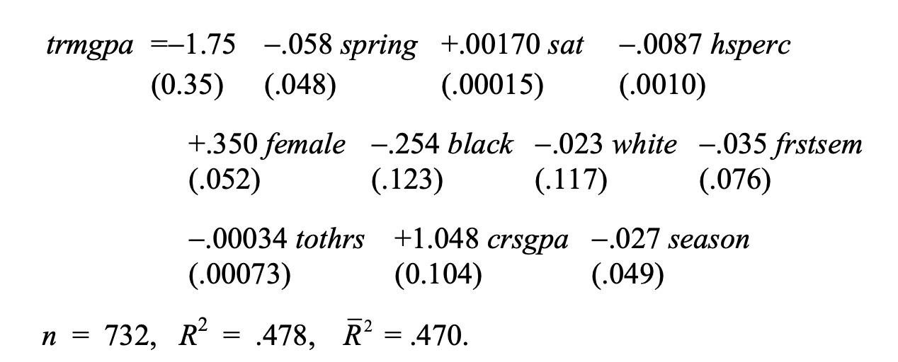
Problem Set 5 - Panel Data Models
Exercise 5.2
Use the data in GPA3.dta for this exercise. The data set is for 366 student athletes from a large university for autumn and spring semesters. Because you have two terms of data for each student, an unobserved effects model is appropriate. The primary question of interest is this: Do athletes perform more poorly in school during the semester their sport is in season?
(a) Use pooled OLS to estimate a model with term GPA (trmgpa) as the dependent variable. The explanatory variables are spring, sat, hsperc, female, black, white, frstsem, tothrs, crsgpa, season. Interpret the coefficient on season. Is it statistically significant?
The coefficient on season implies that, other things fixed, an athlete’s term GPA is about .027 points lower when his/her sport is in season. On a four point scale, this a modest effect (although it accumulates over four years of athletic eligibility). However, the estimate is not statistically significant (t statistic $≈−0.55$).
Note: Use GPA3.dta for this exercise.

Slide 7
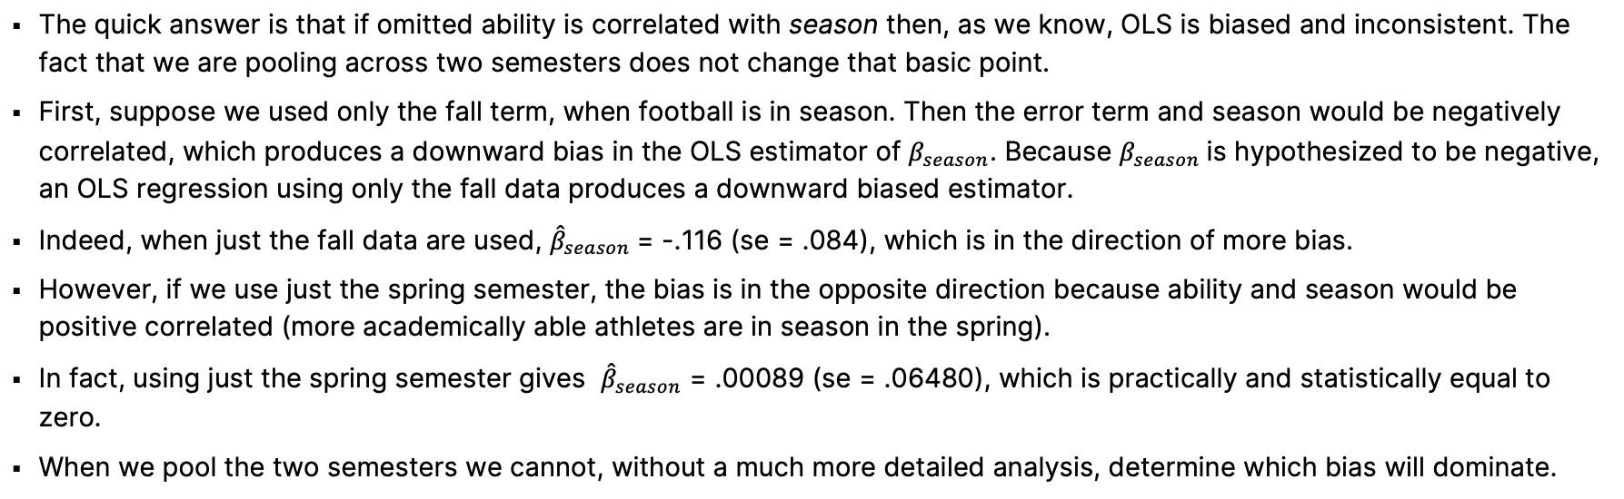
Problem Set 5 - Panel Data Models
Exercise 5.2
(b) Most of the athletes who play their sport only in the fall are football players. Suppose the ability levels of football players differ systematically from those of other athletes. If ability is not adequately captured by SAT score and high school percentage, explain why pooled OLS estimators will be biased.
The quick answer is that if omitted ability is correlated with season then, as we know, OLS is biased and inconsistent. The fact that we are pooling across two semesters does not change that basic point.
First, suppose we used only the fall term, when football is in season. Then the error term and season would be negatively correlated, which produces a downward bias in the OLS estimator of $β_{season}$. Because $β_{season}$is hypothesized to be negative, an OLS regression using only the fall data produces a downward biased estimator.
Indeed, when just the fall data are used, ${\hat{β}}_{season}$= -.116 (se = .084), which is in the direction of more bias.
However, if we use just the spring semester, the bias is in the opposite direction because ability and season would be positive correlated (more academically able athletes are in season in the spring).
In fact, using just the spring semester gives ${\hat{β}}_{season}$ = .00089 (se = .06480), which is practically and statistically equal to zero.
When we pool the two semesters we cannot, without a much more detailed analysis, determine which bias will dominate.
Note: Use GPA3.dta for this exercise.

Slide 8
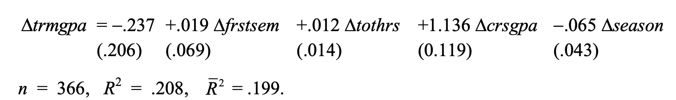
Problem Set 5 - Panel Data Models
Exercise 5.2
(c) Now, use the data differenced across the two terms. Which variables drop out? Now, test for an in-season effect.
Note that the variables sat, hsperc, female, black, and white all drop out because they do not vary by semester. The intercept in the first-differenced equation is the intercept for the spring. Interestingly, the in-season effect is larger now: term GPA is estimated to be about .065 points lower in a semester that the sport is in-season. The t-statistic is about –1.51, which gives a one-sided p-value of about .065.
(d) Can you think of one or more potentially important, time-varying variables that have been omitted from the analysis?
One possibility is a measure of course load. If some fraction of student-athletes take a lighter load during the season (for those sports that have a true season), then term GPAs may tend to be higher, other things equal. This would bias the results away from finding an effect of season on term GPA.
Note: Use GPA3.dta for this exercise.
Notes:
FD: Controls for omitted variables that are constant over time.

Slide 9
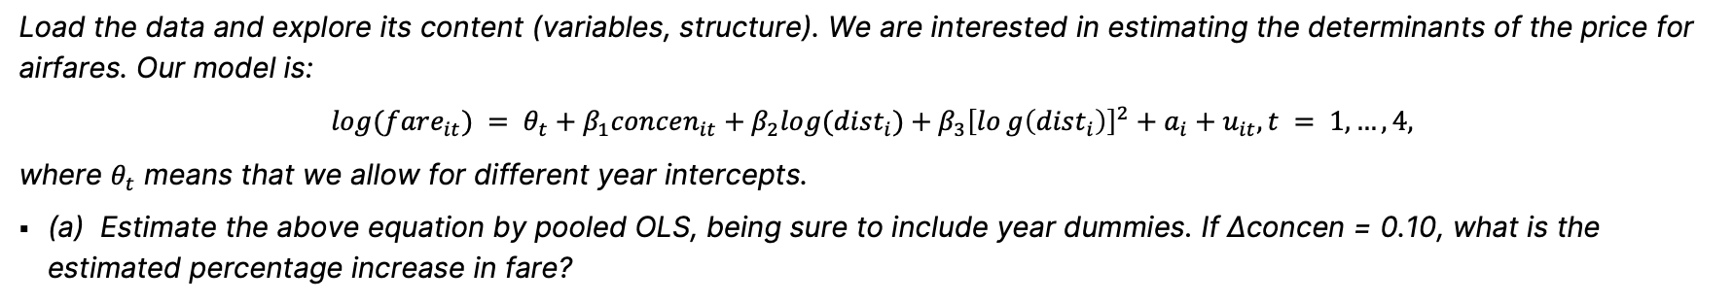
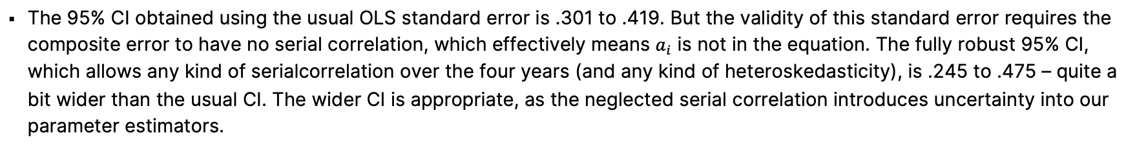
Problem Set 5 - Panel Data Models
Exercise 5.3
Load the data and explore its content (variables, structure). We are interested in estimating the determinants of the price for airfares. Our model is:
$$log⁡(fare_{it}) = θ_{t}+β_{1}concen_{it}+β_{2}log⁡(dist_{i})+β_{3}{\left[log\left(dist_{i}\right)\right]}^{2}+a_{i}+u_{it}, t = 1,…,4,$$
where $θ_{t}$ means that we allow for different year intercepts.
(a) Estimate the above equation by pooled OLS, being sure to include year dummies. If ∆concen = 0.10, what is the estimated percentage increase in fare?
The pooled OLS estimate of $β_{1}$is about .360. If ∆concen = 0.10 then ∆ lfare= .360(.10) =3.6, which means air fare is estimated to be about 3.6% higher.
(b) What is the usual OLS 95% confidence interval for $β_{1}?$ Why is it probably not reliable? Find the heteroscedasticity robust and ”fully” (heteroscedasticity and serial correlation) robust 95% CI for $β_{1}$. Compare it to the usual CI and comment.
The 95% CI obtained using the usual OLS standard error is .301 to .419. But the validity of this standard error requires the composite error to have no serial correlation, which effectively means $a_{i}$ is not in the equation. The fully robust 95% CI, which allows any kind of serialcorrelation over the four years (and any kind of heteroskedasticity), is .245 to .475 – quite a bit wider than the usual CI. The wider CI is appropriate, as the neglected serial correlation introduces uncertainty into our parameter estimators.
Note: Use airfare.dta for this exercise.

Slide 10
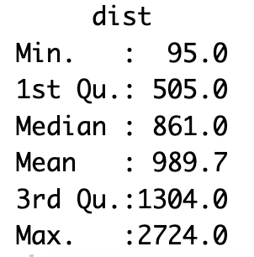
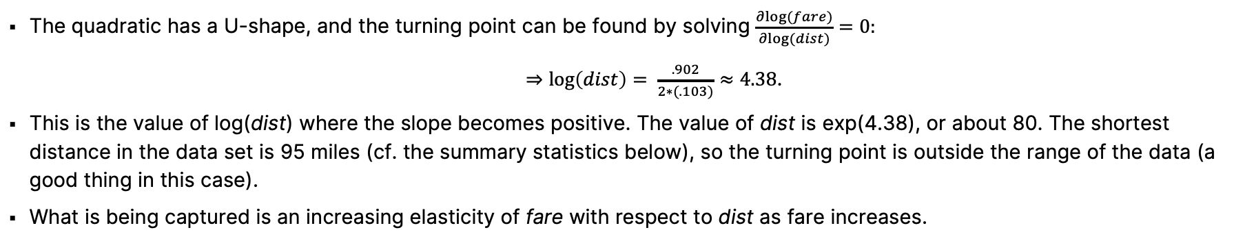
Problem Set 5 - Panel Data Models
Exercise 5.3
(c) Describe what is happening with the quadratic in log(dist). In particular, for what value of dist does the relationship between log(fare) and dist become positive? Is the turning point outside the range of the data?
The quadratic has a U-shape, and the turning point can be found by solving $\frac{∂log⁡(fare)}{∂log⁡(dist)}=0:$
$⇒\log\left(dist\right)= \frac{.902}{2∗(.103)}≈4.38$.
This is the value of log(dist) where the slope becomes positive. The value of dist is exp(4.38), or about 80. The shortest distance in the data set is 95 miles (cf. the summary statistics below), so the turning point is outside the range of the data (a good thing in this case).
What is being captured is an increasing elasticity of fare with respect to dist as fare increases.
Note: Use airfare.dta for this exercise.

Slide 11
Problem Set 5 - Panel Data Models
Exercise 5.3
(d) Now estimate the equation using fixed effects. What is the FE estimate of $β_{1}$?
The FE estimate is .169, which is much lower than the pooled OLS estimate (.360).
(e) Name two characteristics of a route (other than distance between stops) that are captured by $a_{i}$. Might these be correlated with $concen_{it}$?
Factors about the cities near the two airports on a route could affect demand for air travel, such as population, education levels, types of employers, and so on. Of course, each of these can be time-varying, although, over a short stretch of time, they might be roughly constant. The quality of the freeway system and access to trains, along with geographical features (is the city near a river?) would roughly be time-constant. These could certainly be correlated with concentration.
Note: Use airfare.dta for this exercise.

Slide 12
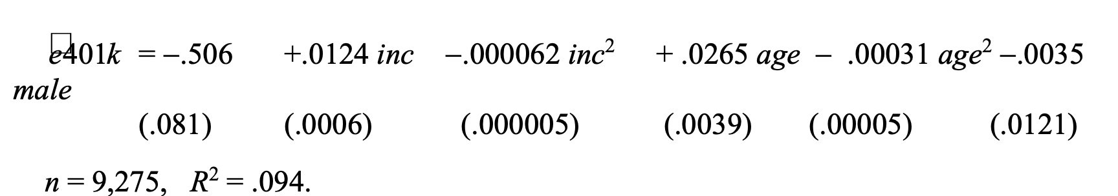
Problem Set 6 - Limited Dependent Variable Models
Exercise 6.1
There has been much interest in whether the presence of 401(k) pensions plans, available to many workers in the U.S., increase net savings. The data set 401KSUBS.dta contains information on net financial assets (nettfa), family income (inc), a binary variable for eligibility in a 401(k) plan (e401k), and several other variables.
(a) What fraction of the families in the sample are eligible for participation in a 401(k) pension plan?
3637 families out of 9275 $=$0.392.
(b) Estimate a linear probability model explaining 401(k) eligibility in terms of income, age, and gender. Include income and age in quadratic form, and report the results in the usual form.
(c) Would you say 401(k) eligibility is independent of income and age? What about gender? Explain.
401(k) eligibility clearly depends on income and age in part (b). Each of the four terms involving inc and age have very. significant t statistics. On the other hand, once income and age are controlled for, there seems to be no difference in eligibility by gender. The coefficient on male is very small – at given income and age, males are estimated to have a .0035 lower probability of being 401(k) eligible – and it has a very small t statistic.
Note: Use 401KSUBS.dta for this exercise.

Slide 13
Problem Set 6 - Limited Dependent Variable Models
Exercise 6.1
(d) Obtain the fitted values from the linear probability model estimated in part (b). Are any fitted values negative or greater than one?
None of the fitted values are outside this interval. The smallest fitted value is about .030 and the largest is about .697. This means one theoretical problem with the LPM – the possibility of generating silly probability estimates – does not materialize in this application.
(e) Using the fitted values $\hat{e410k_{i}}$from part (d), define $\tilde{e401k_{i}}$= 1 if $\hat{e410k_{i}}$ ≥ 0.5 and $\tilde{e401k_{i}}$=0 if $\hat{e410k_{i}}$ < 0.5. Out of 9,275 families, how many are predicted to be eligible for a 401(k) plan?
Using the given rule, 2,460 families are predicted to be eligible for a 401(k) plan. Recall from (a) that 3637 families in the sample are eligble.
Note: Use 401KSUBS.dta for this exercise.

Slide 14
Problem Set 6 - Limited Dependent Variable Models
Exercise 6.1
(f) For 5,638 families not eligible for a 401(k), what percentage of these are predicted not to have a 401(k), using the predictor $\tilde{e401k_{i}}$? For the 3,637 families eligible for a 401(k) plan, what percentage are predicted to have one?
Of the 5,638 families actually ineligible for a 401(k) plan, about 81.7 (=4607 familes) are correctly predicted not to be eligible. Of the 3,637 families actually eligible, only 39.3 percent (= 1429 families) are correctly predicted to be eligible.
(g) The overall percent correctly predicted is about 65% ($=\frac{4607+1429}{9275}∗100$). Do you think this is a complete description of how well the model does, given your answers in part (f)?
The overall percent correctly predicted is a weighted average of the two percentages obtained in part (f). As we saw there, the model does a good job of predicting when a family is ineligible. Unfortunately, it does less well – predicting correctly less than 40% of the time – in predicting that a family is eligible for a 401(k).
Note: Use 401KSUBS.dta for this exercise.

Slide 15
Problem Set 6 - Limited Dependent Variable Models
Exercise 6.2
(a) Define a binary variable, say arr86, equal to unity if a man was arrested at least once during 1986, and zero otherwise. Estimate an LPM relating arr86 to pcnv, avgsen, tottime, ptime86, inc86, black, hispan, and born60. Report the usual and heteroskedasticity-robust standard errors. What is the estimated effect on the probability of arrest if pcnv (= proportion of prior convictions) goes from 0.25 to 0.75?
The heteroscedastic standard errors are largely similar to the standard OLS standard errors and imply no changes in statistical significance.
The coeficient estimated for pcnv is -0.154, so the estimated probability reduces by (0.75-0.25)* -0.154= 7.7 percentage points when pcnv increases from 0.25 to 0.75.
(b) Test the joint significance of avgsen and tottime, using a nonrobust and robust test.
avgsen and tottime are both individually insignificant. When testing for joint significance both the robust and the nonrobust test produces a p-value of ~0.84 , which suggests that the variables are jointly insignificant.
Note: Use GROGGER.dta for this exercise.
Notes:
Avgsen = avg. Sentence length, tottime = time spent in jail since 18.

Slide 16
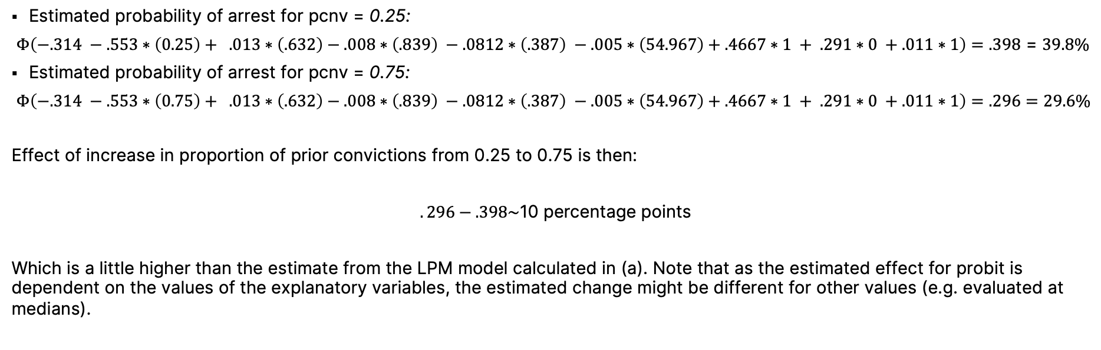
Problem Set 6 - Limited Dependent Variable Models
Exercise 6.2
(c) Now estimate the model by probit. At the average values of avgsen, tottime, inc86, and ptime86 in the sample, and with black = 1, hispan = 0, and born60 = 1, what is the estimated effect on the probability of arrest if pcnv goes from 0.25 to 0.75? Compare this result to the answer in part (a).
Estimated probability of arrest for pcnv = 0.25:
$Φ\left(−.314 −.553∗\left(0.25\right)+ .013∗\left(.632\right)−.008∗\left(.839\right) −.0812∗\left(.387\right) −.005∗\left(54.967\right)+.4667∗1 + .291∗0 +.011∗1\right)=.398$ = 39.8%
Estimated probability of arrest for pcnv = 0.75:
$Φ\left(−.314 −.553∗\left(0.75\right)+ .013∗\left(.632\right)−.008∗\left(.839\right) −.0812∗\left(.387\right) −.005∗\left(54.967\right)+.4667∗1 + .291∗0 +.011∗1\right)=.296=29.6\%$
Effect of increase in proportion of prior convictions from 0.25 to 0.75 is then:
$$.296−.398\text{∼}\text{10 }\text{percentage} \text{points}$$
Which is a little higher than the estimate from the LPM model calculated in (a). Note that as the estimated effect for probit is dependent on the values of the explanatory variables, the estimated change might be different for other values (e.g. evaluated at medians).
Note: Use GROGGER.dta for this exercise.

Slide 17
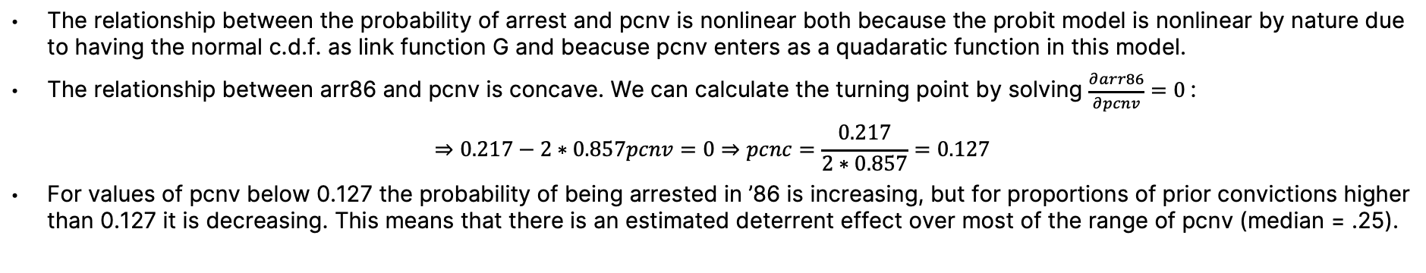
Problem Set 6 - Limited Dependent Variable Models
Exercise 6.2
(d) For the probit model estimated in part (c), obtain the percent correctly predicted. What is the percent correctly predicted when arr86 = 0? When arr86 = 1? What do you make of these findings?
When arr86=0 the percent correctly predicted is 97%, while it is only 10% when arr86=1, which indicates that the model does not perform very well when predicting arr86=1. The overall percent correctly predicted is fairly good at about 73% ($=\frac{1903+78}{2725}∗100$), but when it comes to predicting who gets arrested, which is what we are mainly interested in predicting, our model does not offer good accuracy.
(e) In the probit model, add the terms $pcnv^{2}, ptime{86}^{2}, and inc{86}^{2}$ to the model. Are these individually or jointly significant?
All three variables are individually significant at the 5% level. To test for join significance both Wald and an LR test can be used. Here both suggest that the variables are jointly significant with a p-value = 0.
(e cont.) Describe the estimated relationship between the probability of arrest and pcnv. In particular, at what point does the probability of conviction have a negative effect on probability of arrest?
The relationship between the probability of arrest and pcnv is nonlinear both because the probit model is nonlinear by nature due to having the normal c.d.f. as link function G and beacuse pcnv enters as a quadaratic function in this model.
The relationship between arr86 and pcnv is concave. We can calculate the turning point by solving $\frac{∂arr86}{∂pcnv}=0$:
$$⇒0.217−2∗0.857pcnv=0⇒pcnc=\frac{0.217}{2∗0.857}=0.127$$
For values of pcnv below 0.127 the probability of being arrested in ’86 is increasing, but for proportions of prior convictions higher than 0.127 it is decreasing. This means that there is an estimated deterrent effect over most of the range of pcnv (median = .25).
Note: Use GROGGER.dta for this exercise.

Slide 18
Problem Set 6 - Limited Dependent Variable Models
Se type | Normal | clustered | robust
choice | 12.05* | 12.05* | 12.05**
 | (6.298) | (6.184) | (5.994)
age | -1.626** | -1.626** | -1.626*
 | (0.775) | (0.819) | (0.833)
educ | 0.754 | 0.754 | 0.754
 | (1.207) | (1.180) | (1.172)
female | 1.303 | 1.303 | 1.303
 | (7.164) | (7.001) | (7.149)
black | 3.967 | 3.967 | 3.967
 | (9.783) | (8.712) | (8.975)
married | 3.303 | 3.303 | 3.303
 | (7.998) | (8.624) | (8.370)
finc25 | -18.19 | -18.19 | -18.19
 | (14.12) | (16.83) | (16.00)
finc35 | -3.925 | -3.925 | -3.925
 | (14.49) | (16.18) | (15.86)
finc50 | -8.129 | -8.129 | -8.129
 | (14.34) | (15.91) | (15.38)
finc75 | -17.58 | -17.58 | -17.58
 | (16.08) | (17.28) | (16.68)
finc100 | -6.746 | -6.746 | -6.746
 | (15.79) | (17.25) | (16.75)
finc101 | -28.34 | -28.34* | -28.34*
 | (17.90) | (17.11) | (16.58)
wealth89 | -0.00269 | -0.00269 | -0.00269
 | (0.0125) | (0.0119) | (0.0114)
prftshr | 15.81** | 15.81* | 15.81*
 | (7.333) | (8.356) | (8.108)
Constant | 134.1** | 134.1** | 134.1**
 | (55.71) | (58.13) | (58.87)
Observations | 194 | 194 | 194
R-squared | 0.100 | 0.100 | 0.100
Standard errors in parentheses. *** p<0.01, ** p<0.05, * p<0.1
Exercise 6.3
(a) Estimate a linear model for pctstck, where the explanatory variables are choice, age, educ, female, black, married, finc25,...,finc101, wealth89, and prftshr with normal and with heteroscedasticity robust standard errors. The sample contains separate observations for some husband-wife pairs. Compute standard errors of the estimates from the model that account for the cluster correlation within family. (These should also be heteroskedasticity-robust.) Do the standard errors differ from the usual OLS or heteroskedasticity robust standard errors?
When we compare the usual OLS standard errors to the heteroscedasticity robust SE, we observe that they are often similar but there are several changes. For example our main variable of interest, choice, is not significant at the 5% level in the case of the usual OLS and clustered SE but it is in the case of the heteroscedasticity robust SE. This illustrates that even small changes can have an important effect for the conclusions of empirical work.
Note: Use PENSION.dta for this exercise.

Slide 19
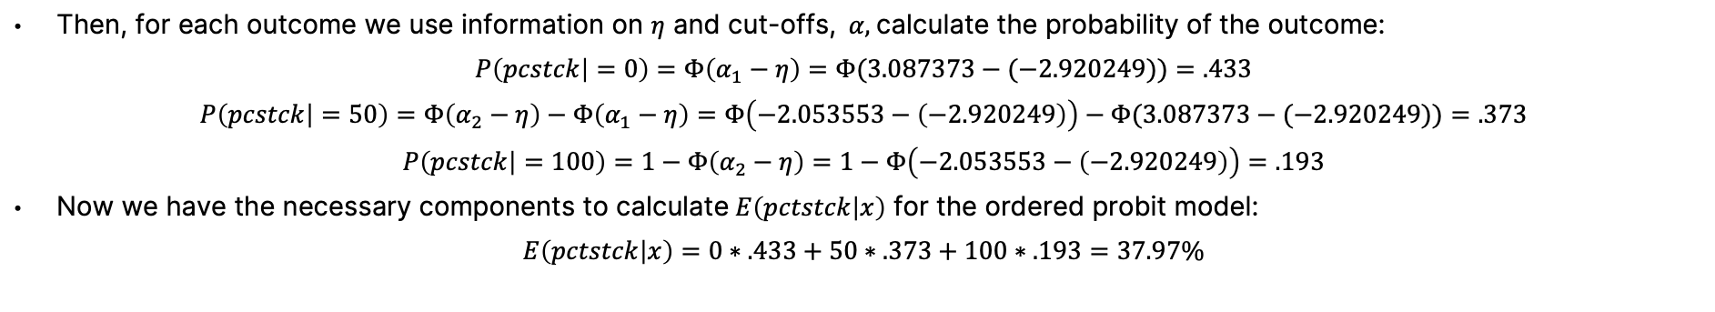
Problem Set 6 - Limited Dependent Variable Models
Exercise 6.3
(b) Estimate the model from part (a) with ordered probit. Estimate $E(pctstck|x)$for a single, nonblack female with 12 years of education who is 60 years old. Assume she has net worth (in 1989) equal to $150,000 and earns $45,000 a year, her plan is not profit sharing and choice = 0. Compare this with the estimate of $E(pctsck|x)$from the linear model.
To calculate this for the ordered probitwe will first compute the linear index,$η=X_{0}\hat{β}$for the selected values, $X_{0}$:
$$η=.371∗0−.050∗60+.026∗12+ .046∗1+.093∗0+.094∗0−.578∗0−.135∗0−.262∗1 −.566∗0−.228∗0−.864∗0−.0000956∗150+ .4817182∗0=−2.920$$
Then, for each outcome we use information on $η$ and cut-offs,$α,$calculate the probability of the outcome:
$$P\left(pcstck | =0\right)=Φ\left(α_{1}−η\right)=Φ(3.087373−(−2.920249))=.433$$
$$P\left(pcstck | =50\right)=Φ\left(α_{2}−η\right)−Φ\left(α_{1}−η\right)=Φ\left(−2.053553−\left(−2.920249\right)\right)−Φ(3.087373−(−2.920249))=.373$$
$$P\left(pcstck | =100\right)=1−Φ\left(α_{2}−η\right)=1−Φ\left(−2.053553−\left(−2.920249\right)\right)=.193$$
Now we have the necessary components to calculate $E\left(pctstck | x\right)$ for the ordered probit model:
$$E\left(pctstck | x\right)=0∗.433+50∗.373+100∗.193=37.97\%$$
For the linear prediction, we calculate $E\left(pctstck | x\right)$ the standard way by $X_{0}\hat{β}$and get $E\left(pctstck | x\right)=$38.37%, so the linear model produces a slightly higher prediction though the difference is small.
Note: Use GROGGER.dta for this exercise.

Slide 20
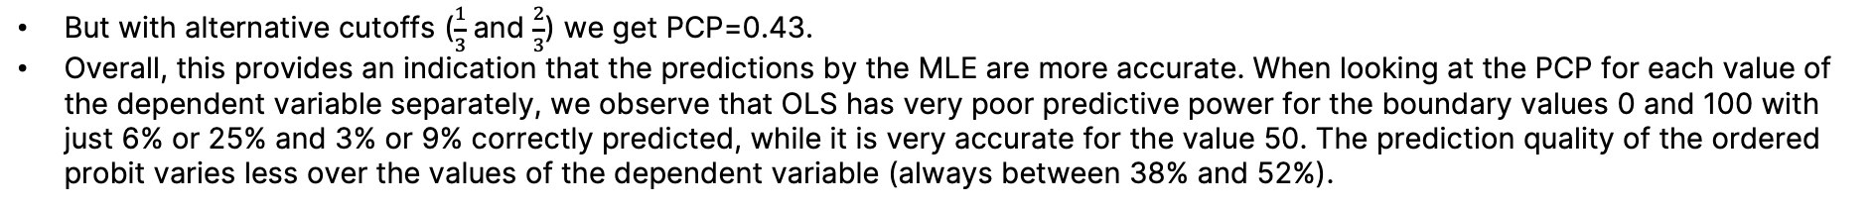
Problem Set 6 - Limited Dependent Variable Models
Exercise 6.3
(c) If you want to choose between the linear model and ordered probit model based on how well each estimates E(y|x), how would you proceed?
One way to compare model fit is to compare percentage correctly predicted (PCP).
For the probit model the PCP:
$$\frac{33+31+22}{194}∗100=44.32\%$$
For the linear prediction, we calculate the fitted values for each observation and use these to alocate each observation to a categorical outcome. Dependent on how we use the fitted values to alocate observations to categorical outcome, we get different PCP. Using if $\hat{pctstck≤}$25 $\tilde{pctstck=0, }$if $\hat{pctstck>}$25 and $\hat{pctstck<}\text{50} \tilde{pctstck=50 .}\text{If} \hat{pctstck≥} \text{50} \tilde{pctstck=100 },$we get PCP:
$$PCP=0∗.433+50∗.373+100∗193=40.20\%$$
But with alternative cutoffs ($\frac{1}{3}$and $\frac{2}{3}$) we get PCP=0.43.
Overall, this provides an indication that the predictions by the MLE are more accurate. When looking at the PCP for each value of the dependent variable separately, we observe that OLS has very poor predictive power for the boundary values 0 and 100 with just 6% or 25% and 3% or 9% correctly predicted, while it is very accurate for the value 50. The prediction quality of the ordered probit varies less over the values of the dependent variable (always between 38% and 52%).
Note: Use GROGGER.dta for this exercise.

Slide 21
Problem Set 6 - Limited Dependent Variable Models
Exercise 6.3
(d) Define a variable invest = 0 if pcstck = 0, invest = 1 if pcstck = 50, invest = 2 if pcstck = 100. Estimate the ordered probit model of part (b) but with invest as the dependent variable. Are there any interesting quantities that would differ between using pcstck and invest as the dependent variables?
The results in the output table are the same because the estimator does not consider the actual values of the dependent variable (as long as their order is preserved). The only difference between the two models stems from the fact that pctstck has quantitative meaning. As done in part (b) this allows to compute meaningful expected values of the dependent variable and therefore also partial effects.
Note: Use GROGGER.dta for this exercise.

